Slide 1
WORK PLAN
TOP-DOWN APPROACH
WORK PLAN

Slide 2
content
1
Introduction
4
Example
Explain, briefly introduce the concept
Illustrated with C#
5
Real-World
2
Benefits
Highlight the advantages
Top-down approach in real world
Steps in Top-Down
6
Conclusion
3
How to apply in programming
Overall top-down approach
CONTENT

Slide 3
01
Introduction

Slide 4

Introduction
In programming, the top-down approach tackles complex problems by dividing them into more manageable subproblems.
Each subproblem is then solved individually, and these solutions are seamlessly integrated to achieve the overall solution. This technique, often called "Subproblem Reduction" among programmers

Slide 5
02
Benefits

Slide 6

Benefits
Clearer overview
Top-down approach yields clear and organized code, minimizing confusion with centralized decisions and streamlined communication.
Well-known style
Helping programmers from similar backgrounds . Team leader incorporate familiar top-down methods to help them adjust quickly.
Faster execution
Efficient problem-solving
Help to tracing issues to their origin when they occur. Make it easier to find, diagnose, and resolve problems
Quicker execution as decisions are made at a single level, enabling faster finalization, distribution, and implementation.

Slide 7
03
Step-in Top-down

Slide 8

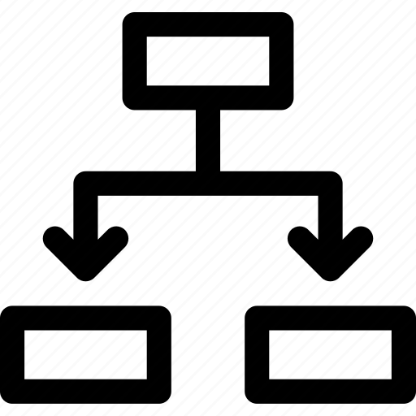
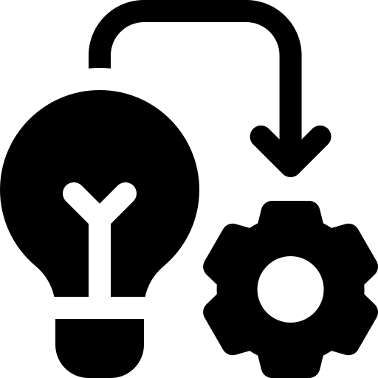


Top-down approach in programming
Establishing the required steps before implementing a method provides clear insights and you can follow this:
Specify the PROBLEM:
What are the inputs and outputs of the program?
What are the intended functions?
What are the primary tasks the program must execute?
Can we further break down these tasks into smaller sub-tasks?
Divide into smaller problems:
This makes the program easier to change
and use in different situations.
Create individual functions for each sub-problem:
Call the sub-functions from the main function:
The main function should just coordinate
the running of the sub-functions.
Ensure each part is solved correctly and check
if the entire program works as intended.
Test and debug the program:

Slide 9
04
Example

Slide 10
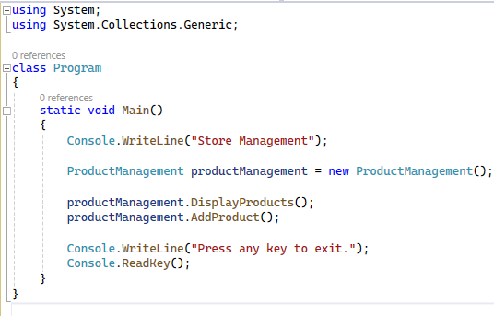
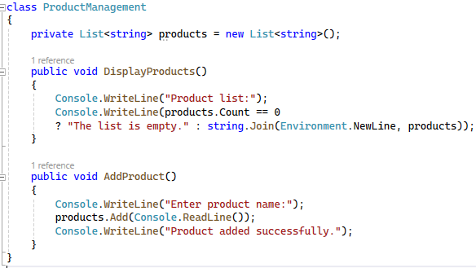
illustrated with c#
Below is a simplified version of the C# code that focuses only on displaying and adding products:

Slide 11
illustrated with C#
The program is a simple application that manages products in the store
Main Method: Still serves as the starting point, managing the main objects and functions of the program.

Slide 12
illustrated with C#
ProductManagement Class: This class is still responsible for managing product listings and related functions such as displaying and adding products.
DisplayProducts Method and AddProduct Method: Still smaller components, responsible for specific functions.

Slide 13
05
Real-world

Slide 14

What Tech Companies Use the Top-Down Approach?
Here are some examples of tech companies that are known for incorporating the top-down approach in their software development processes:
Microsoft
IBM
Oracle
Google
Amazon
Facebook
Apple

Slide 15
06
Conclusion

Slide 16

Conclusion
Overall, the top-down approach promotes a logical and organized development process, leading to software solutions that are not only scalable and maintainable but also aligned with the overall goals of the project.
Its adaptability makes it a valuable methodology in various tech companies for creating robust and efficient software systems.

Slide 17
WORK PLAN
Thanks for watching
WORK PLAN

